Slide 1
The Romantic Period (1820 – 1900)
Lecture by Kenny Lim

Slide 2
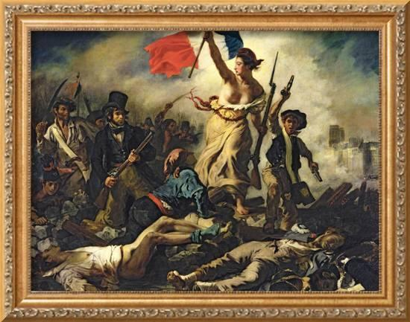

Slide 3
Composer’s role
Inspired by Beethoven
“Free artist” mindset
Create extended works with no immediate prospects for performance
Due to French revolution and Napoleonic wars, aristocrats could no longer afford to maintain private opera houses, orchestras, and “composer in residence”
Middle-class rise due to industrial revolution, public orchestra and opera houses are formed
Some composer had wealthy patrons support

Slide 4
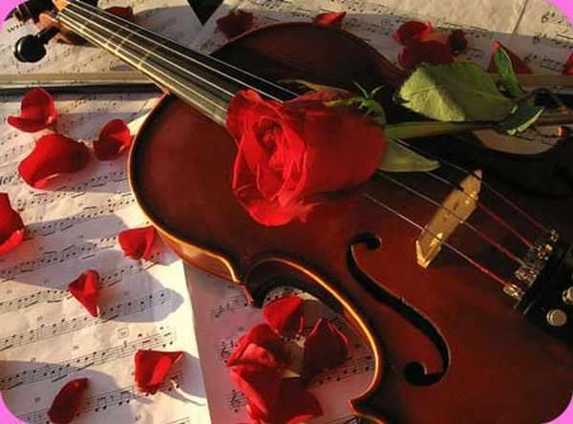
Romanticism in Music
Continued to use the musical forms of the preceding classical era
Preference for expressive, songlike melody
Linked more closely to the other arts, particularly to literature
Romantic period music are very diverse

Slide 5
Characteristic of Romantic Music
Individuality of style
Nationalism and exoticism
Expressive aims and subject
Expressive tone color
Colorful harmony
Expanded range of dynamics

Slide 6
Form: Miniature and Monumental
Composer expressed themselves both in musical miniatures and in monumental compositions.
Miniature works are meant to be heard in the intimate surroundings of a home; they met the needs of the growing number of people who owned pianos.
Monumental works call for a huge number of performers, lasts for several hours, and were designed for large opera houses or concert halls.
New techniques were used to unify such long works
Thematic transformation: character of the theme is transformed

Slide 7
The Art Song
Composition for solo voice and piano
Originally written to be sung and enjoyed at home
Fused intimately with poetry
Favored poets such as Johann Wolfgang von Goethe & Heinrich Heine
Composers would interpret a poem, translating it’s mood, atmosphere, and imagery into music.

Slide 8
Song forms
Strophic form – repeats the same music for each stanza of the poem
Through-composed form – new music for each stanza
Modified strophic form – main melody is repeated for two/three stanzas but has new/varied material when text requires
Song Cycle
Romantic art songs that are sometimes grouped in a set, is called a song cycle
*Stanza – A group of lines of poetry forming a unit. (Cambridge dictionary)

Slide 9
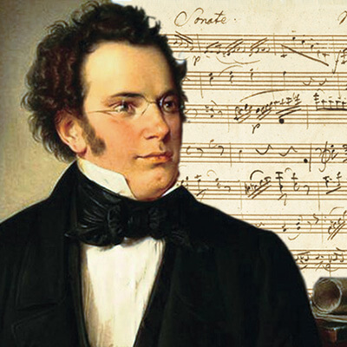
Franz Schubert (1797 – 1828)
Composed more than 600 songs, alongside symphonies, string quartets and several other works
Famous compositions: Gretchen am Spinnrade (Gretchen on a spinning wheel); The Erlking
His songs embrace an enormous variety of moods and types
His melodies range from simple, folklike tunes to complex lines that suggest impassioned speech.
Uses imaginative harmonies to provide poetic moments in music: unexpected dissonances, abrupt shifts to contrasting keys.
“It bears within it the seeds of everlasting youth.” – Schumann on Schubert’s Unfinished Symphony

Slide 10
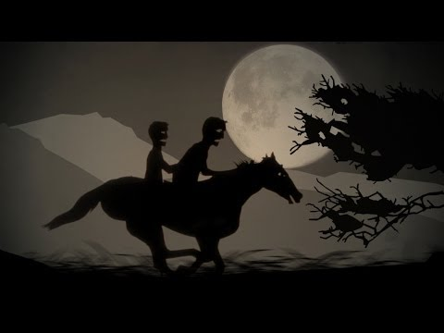

Slide 11
Erlkonig (The Erlking: 1815)
Die Forelle (The Trout); 1817

Slide 12
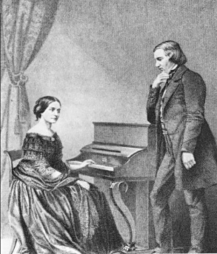
Robert Schumann (1810 – 1856)
His works are intensely autobiographical, usually linked with descriptive titles, texts, or programs.
The first music reviewer
Usually organizes his music in to sets or cycles – Carnaval (Carnival), Kinderscenen (Scenes of Childhood), Fantasiestucke (Fantasy Pieces)
His works are full of extramusical references
Composed piano works, art songs, symphonies and chamber music
Has great gift for melody
Eusebius and Florestan

Slide 13
Fantasiestucke Op. 12 (Fantasy Pieces for Piano; 1837)
Aufschwung (Soaring; 1837)
Warum? (Why? 1837)

Slide 14
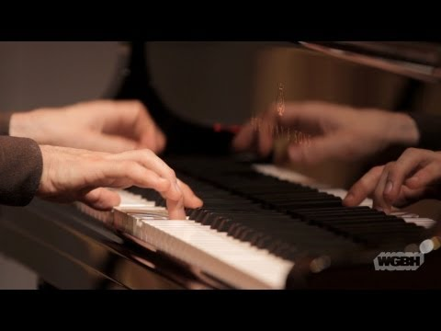

Slide 15
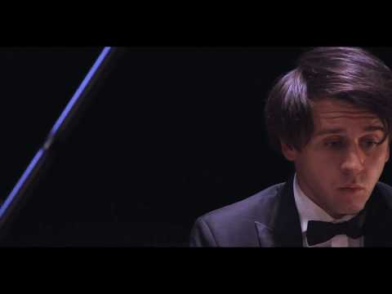

Slide 16
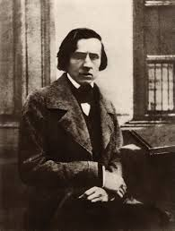
Frederic Chopin (1810 – 1849)
Poet of the piano
Unique melodic gift creates the illusion that the piano is singing, no composer has made the piano sound as beautiful as Chopin
Most pieces are short, but Chopin evokes an infinite variety of moods, from melancholy to heroism.
Elegant and graceful music
Works such as Mazurkas and polonaises

Slide 17
Nocturne in E-flat major, Op. 9, No. 2
Nocturne = night piece
Slow, lyrical, intimate composition for piano
Etude in C minor, Op. 10, No. 12 (Revolutionary; 1831?)
Etude is a study piece designed to help a performer master specific technical difficulties
Inspired by the Russian takeover of Warsaw in 1831
Polonaise in A flat major; Op. 53 (1842)
A stately processional dance for the Polish nobility

Slide 18
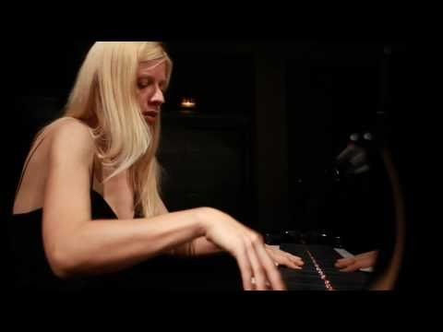

Slide 19
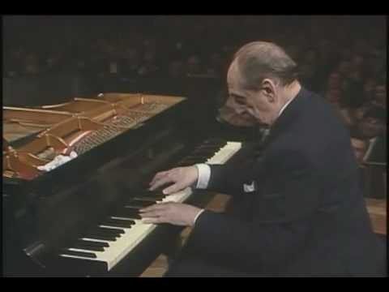

Slide 20
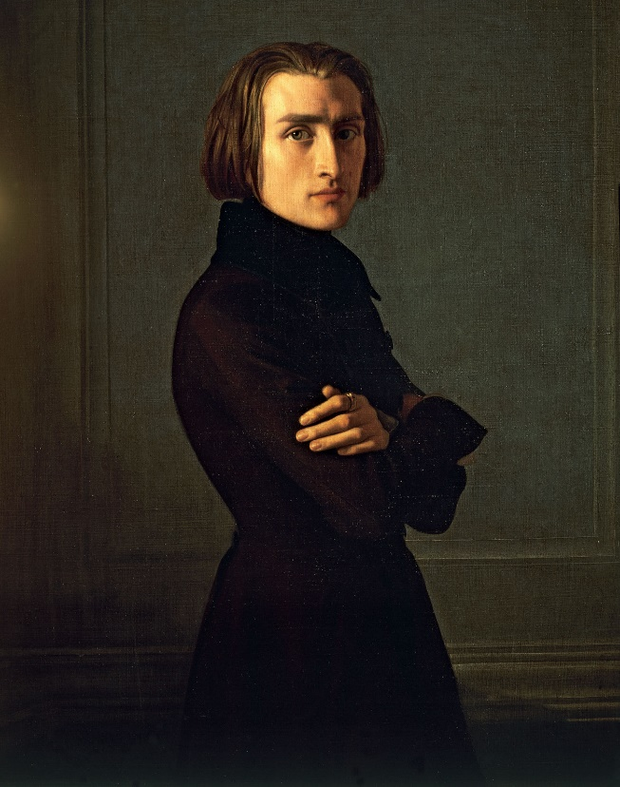
Franz Listz (1811 – 1886)
Handsome
Virtuosic
Hungary’s greatest pianistic showman in history
Found new ways to exploit the piano: demand an unprecedented range of dynamics ; rapid octaves and daring leaps
Transcendental Etude No. 10 in F minor (1851)

Slide 21
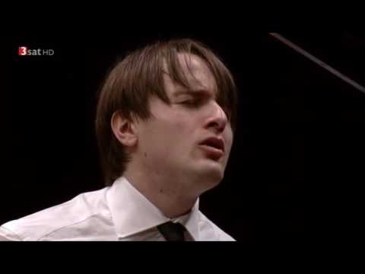

Slide 22
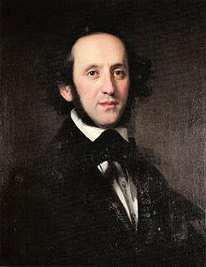
Felix Mendelssohn (1809 – 1847)
Music was deeply rooted in classical tradition
Extremely talented, on par with Mozart
Rekindled Bach’s music
His music reflects his elegance and balance personality
Wrote all form of romantic music except opera
Concerto for Violin and Orchestra in E minor (1844)

Slide 23
Programme Music
Instrumental music associated with a story, poem, idea, or scene
The nonmusical element is usually specified by a title or by explanatory comments called a programme.
Became prominent in the romantic period, when music was closely associated with literature.
Artist in all fields were intoxicated by the concept of “union of the arts”. Poets wanted their poetry to be musical, and musicians wanted their music to be poetic.
Most romantic program music was written for piano or for orchestra
Orchestral program music: program symphony, concert overture, symphonic poem and incidental music.

Slide 24
Program Symphony
A symphony with a program
Composition in several movements, each movement has a descriptive title
Berlioz’s Fantastic Symphony
(1) Reveries, Passion
(2) A Ball
(3) Scene in the Country
(4) March to the Scaffold
(5) Dream of a Witch’s Sabbath

Slide 25
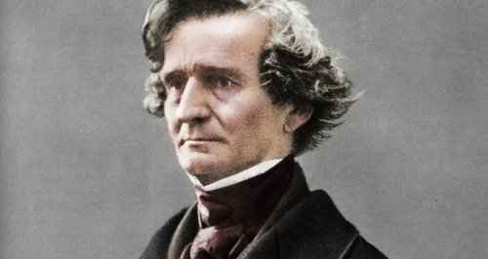
Hector Berlioz (1803 – 1869)
Extraordinarily imaginative in treating the orchestra, creating tone colors never before heard.
Abrupt contrast, fluctuating dynamics, and many changes in tempo
Sound effects
Symphonie fantastique (Fantastic Symphony)
Invented new forms:
“Dramatic symphony” Romeo and Juliet (1839): Orchestra, chorus and vocal soloists
“Dramatic legend” The Damnation of Faust (1846): Combines opera and oratorio

Slide 26
Fourth Movement: March to the Scaffold Allegretto non troppo
“He dreams that he has murdered his beloved, that he has been condemned to death and is being led to the scaffold. The procession moves forward to the sounds of a march that in now somber and fierce, now brilliant and solemn, in which the muffled sounds of heavy steps give way without transition to the noisiest outbursts. At the end, the idee fixe returns for a moment, like a last thought of love interrupted by the death blow.”

Slide 27
Concert Overture
Only one movement
Usually in Sonata form
Modeled after the opera overture, but the work is not intended to usher in a stage work; it is an independent composition.
Symphonic poem or tone poem
One movement
Either in sonata, rondo, or theme and variations – as well as irregular forms
Flexibility of forms distinguishes it from Concert overture

Slide 28
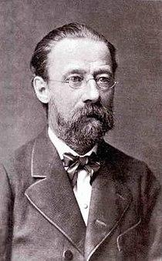
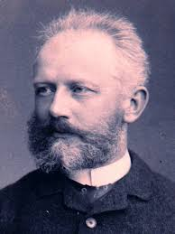
Bedrich Smetana (1824 – 1884)
His works based on folk songs, dances and legend of his native Bohemia
The moldau (part of Ma Vlast)
Pyotr Ilyich Tchaikovsky (1840 – 1893)
Russian melodist
His music contains beautiful melodies that stretch and leap wildly
Style was influenced by folk songs
Fused national and international element to produce intensely subjective and passionate music

Slide 29
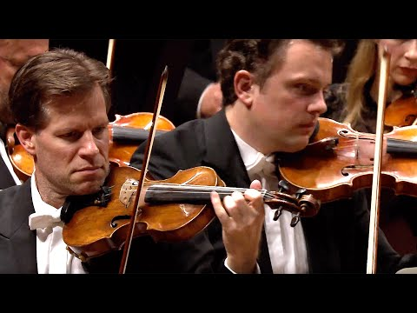

Slide 30
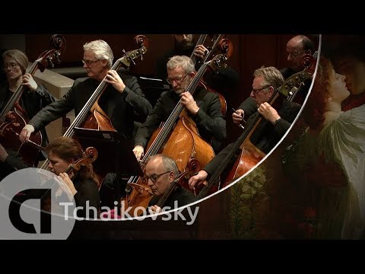

Slide 31
Incidental music
Music intended to be performed before and during a play
Interludes, background music, marches, and dances are all incidental music (as are today’s movie scores)

Slide 32
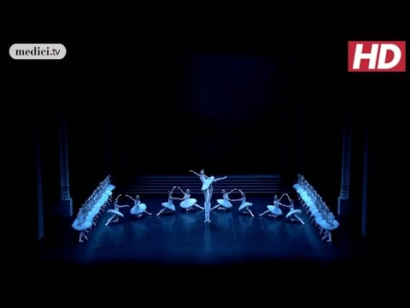

Slide 33
Nationalism
A revolutionary political movement, nationalism led to the unification of lands.
The national past became a subject of intense historical investigation, and there was new enthusiasm for folksongs, dances, legends and fairytales.
Composers gave their works a distinct national identity.
Composers used folksongs and dances to create original melodies with a folk flavor
Operas and program music were inspired by history, legends, and landscapes of their native lands.

Slide 34
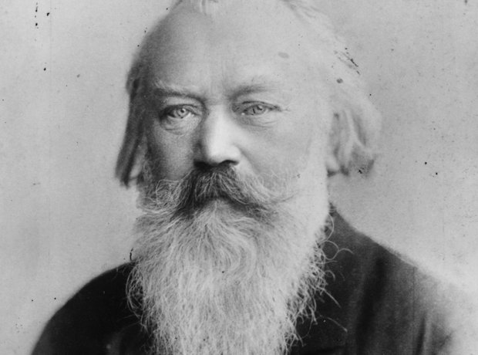
Johannes Brahms (1833 – 1897)
Used two against three rhythmic patterns
Lyricism
Rich, dark tone colors in orchestral works
Theme and variation form
Symphony No.3 in F major (1883)

Slide 35
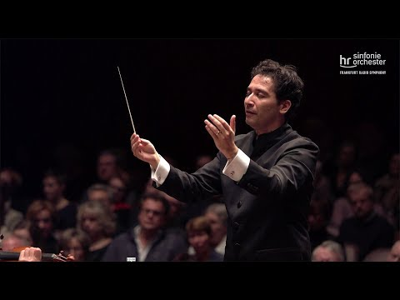

Slide 36
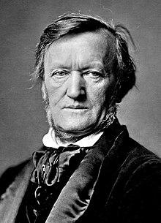
Richard Wagner (1813 – 1883)
Virtually monopolized the German opera
Der Ring des Nibelungen (The Ring of the Nibelung): The Ring Cycle
Das Rheingold
Die Walkure
Siegfried
Gotterdammerung

Slide 37
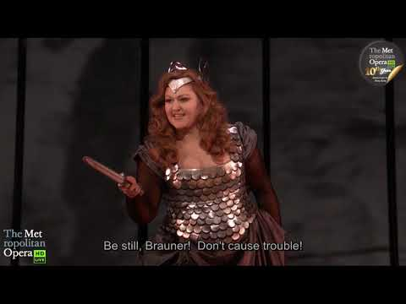

Slide 38
Questions
What is Programme music?
Instrumental music associated with a story, poem, idea, or scene
What is Art song?
Composition for Piano and Vocal
Name two composer who represents Nationalism in their works
Smetana & Tchaikovsky

